Slide 1
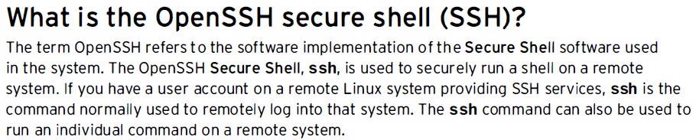
CONFIGURING AND SECURING
OPENSSH SERVICEs
OMKAR M. BHAGAT

Slide 2
Configure ssh on server side
run commands as root
Install ssh
yum install openssh*
Or
rpm –ivh openssh*
Or
yum install –y openssh-server
OMKAR M. BHAGAT

Slide 3
Configure ssh on server side
2. To see installed packages
rpm –qa openssh*
3. To check and start service
service sshd status
Or: systemctl status sshd

Slide 4
Configure ssh on server side
service sshd start
4. To check status after service start:
systemctl status sshd
5. In case, we want as the system restarts, service should automatically start:
systemctl enable sshd {permanently service is on, even system is shutdown}
OMKAR M. BHAGAT

Slide 5
Configure ssh on server side
6. If want to enable firewall for any service in linux:
firewall-cmd - - permanent - -add-service ssh
Reload after above command
firewall-cmd - -reload
OMKAR M. BHAGAT

Slide 6
Configure ssh on server side
8. Again restart sshd service:
systemctl reload sshd
-----------------------------------------------
To configure ssh for some user:
1.
useradd a passwd a
useradd b passwd b
OMKAR M. BHAGAT

Slide 7
Configure ssh on server side
(To) check main configuration file to check whether password authentication is enabled or not?
gedit /etc/ssh/sshd_config
In that file, goto: #PasswordAuthentication yes
(uncomment # if already commented.)
OMKAR M. BHAGAT

Slide 8
Configure ssh on server side
3. restart service
service sshd restart
4. To show server IP
ifconfig (Note the server IP)
Then login with the username:
ssh a@......server IP here…..
Type: YES
Password: put password of user a
OMKAR M. BHAGAT

Slide 9
Configure ssh on server side
After putting password, check all user login :
who
whoami
OMKAR M. BHAGAT

Slide 10
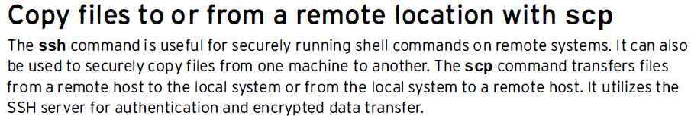
Copying Files Between Systems

Slide 11
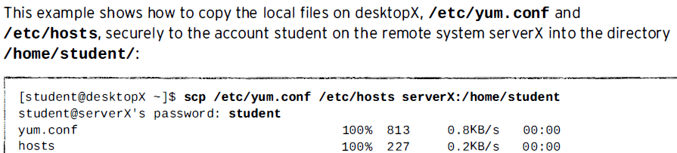
Copying Files Between Systems

Slide 12
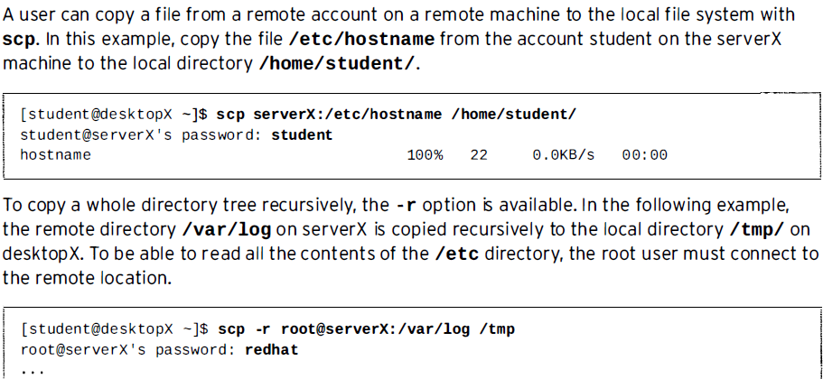
Copying Files Between Systems

Slide 13
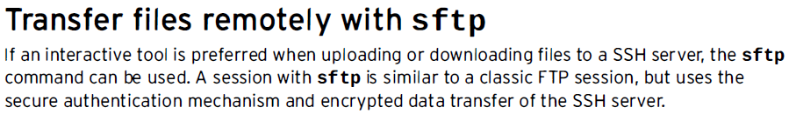
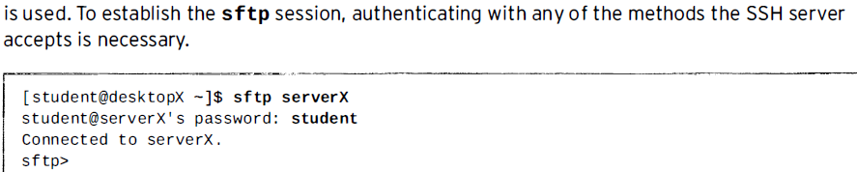

Slide 14
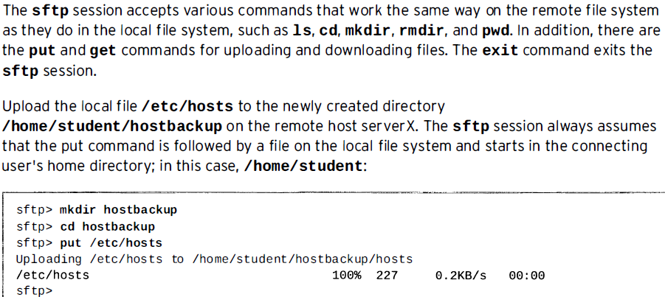

Slide 15
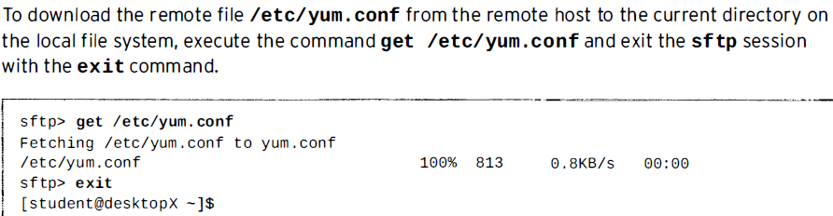

Slide 16
Practice: Copying Files Over the Network With scp

Slide 17
Login as root
ssh student@localhost
Or ssh student@127.0.0.1
Whoami
who

